Slide 1
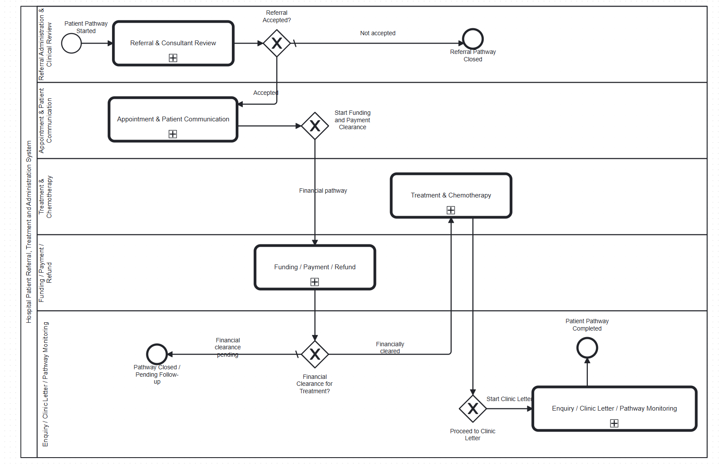
603 DEVELOPMENT PRESENTATION
Hospital Master BPMN
03
1. The master process coordinates referral, appointment, finance, treatment, and clinic-letter work as one patient journey.
2. A positive decision in one area creates the data and control needed by the next area.
3. Human decisions stay in forms. Automated checks run through Camunda workers.
4. This integrated design prevents a treatment activity from starting before relevant referral, appointment and financial decisions are available.

Slide 2
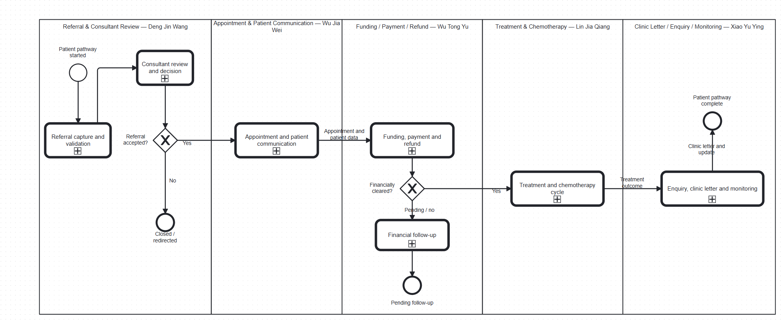
603 DEVELOPMENT PRESENTATION
Strategic BPMN: The Hospital Pathway
04
1. The strategic view starts with a referral and moves through booking, funding, treatment and follow-up communication.
2. It shows why each operational process exists and where a patient depends on the next service.
3. The operational BPMN models implement these stages with tasks, gateways, forms and workers.

Slide 3
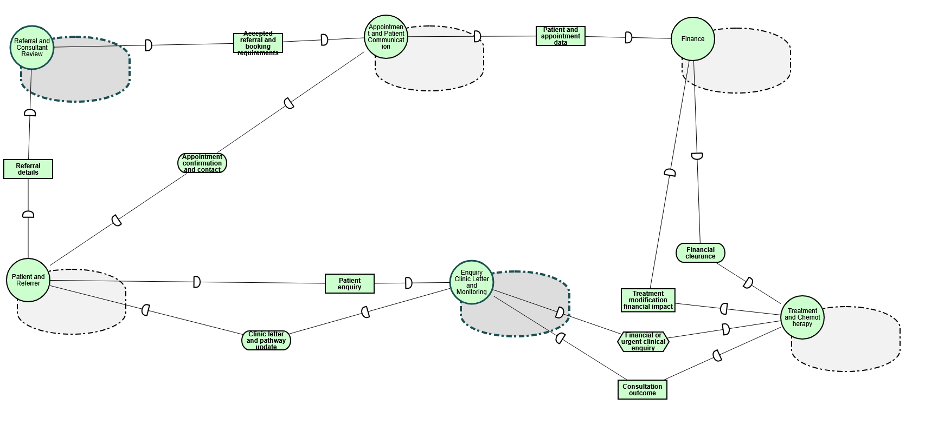
603 DEVELOPMENT PRESENTATION
Strategic Dependency Model: Who Depends on Whom
05
1. The SD model contains six actors: Patient and Referrer, Referral and Consultant Review, Appointment and Patient Communication, Finance, Treatment and Chemotherapy, and Enquiry Clinic Letter and Monitoring.
2. Dependencies make hand-offs visible. Examples include referral details, accepted referral and booking requirements, financial clearance, consultation outcome and clinic letter updates.
3. The SD model supports accountability because each dependency has a depender, a dependee and a concrete dependum.

Slide 4
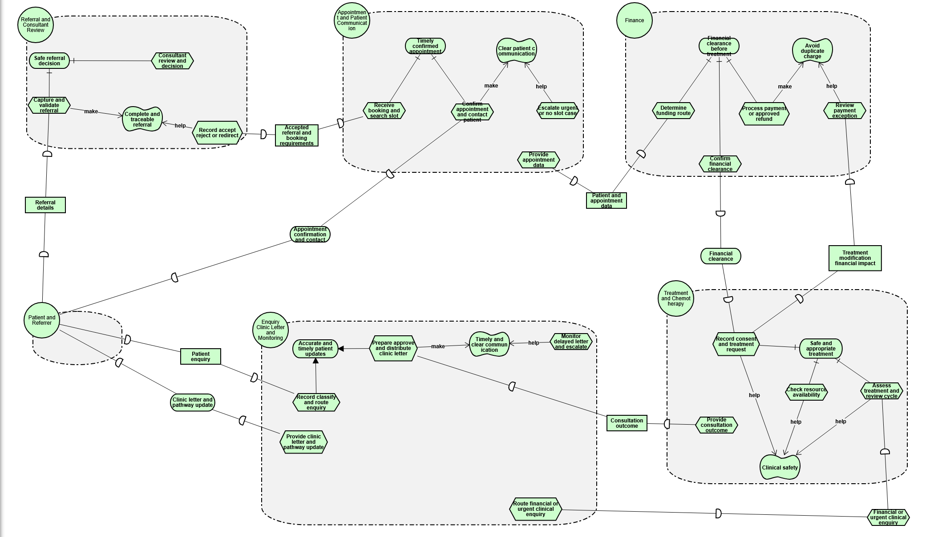
603 DEVELOPMENT PRESENTATION
Strategic Rationale Model: Goals and Decisions
06
1. The SR model explains why each actor performs its tasks.
2. Referral work supports a safe referral decision and complete, traceable referral.
3. Appointment work supports a timely confirmed appointment and clear patient communication. Finance supports financial clearance before treatment. Treatment supports clinical safety. Enquiry and letter work supports accurate, timely updates.
4. AND refinements show activities that must work together. OR refinements show alternative ways to achieve a goal.

Slide 5
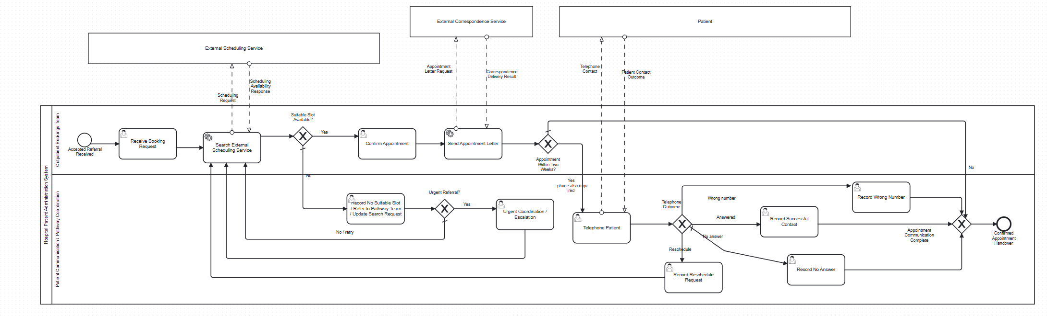
603 DEVELOPMENT PRESENTATION
Appointment
07
appointment confirmation and the patient-facing communication route. Explain how an appointment outcome becomes a controlled process decision.
update:Modelled and connected. The next action was to verify their forms and integration conditions.

Slide 6
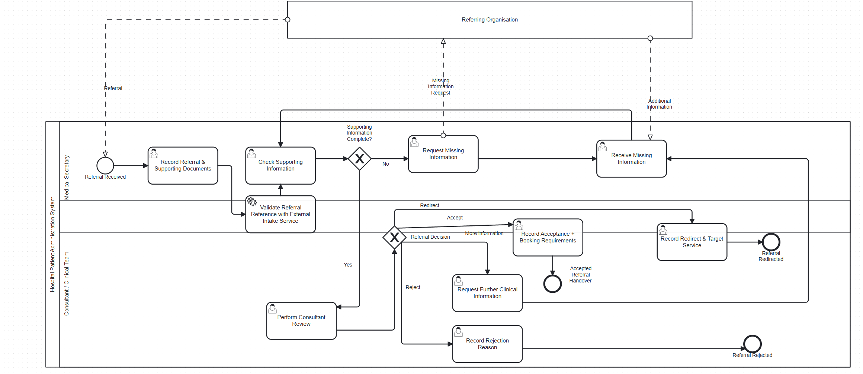
Referral
The referral and consultant-review route. Explain how the referral details, consultant decision and safe routing support a traceable referral.

Slide 7
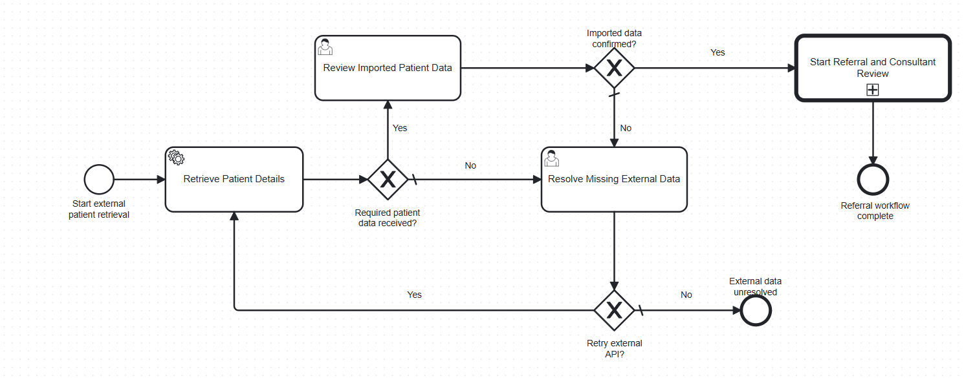
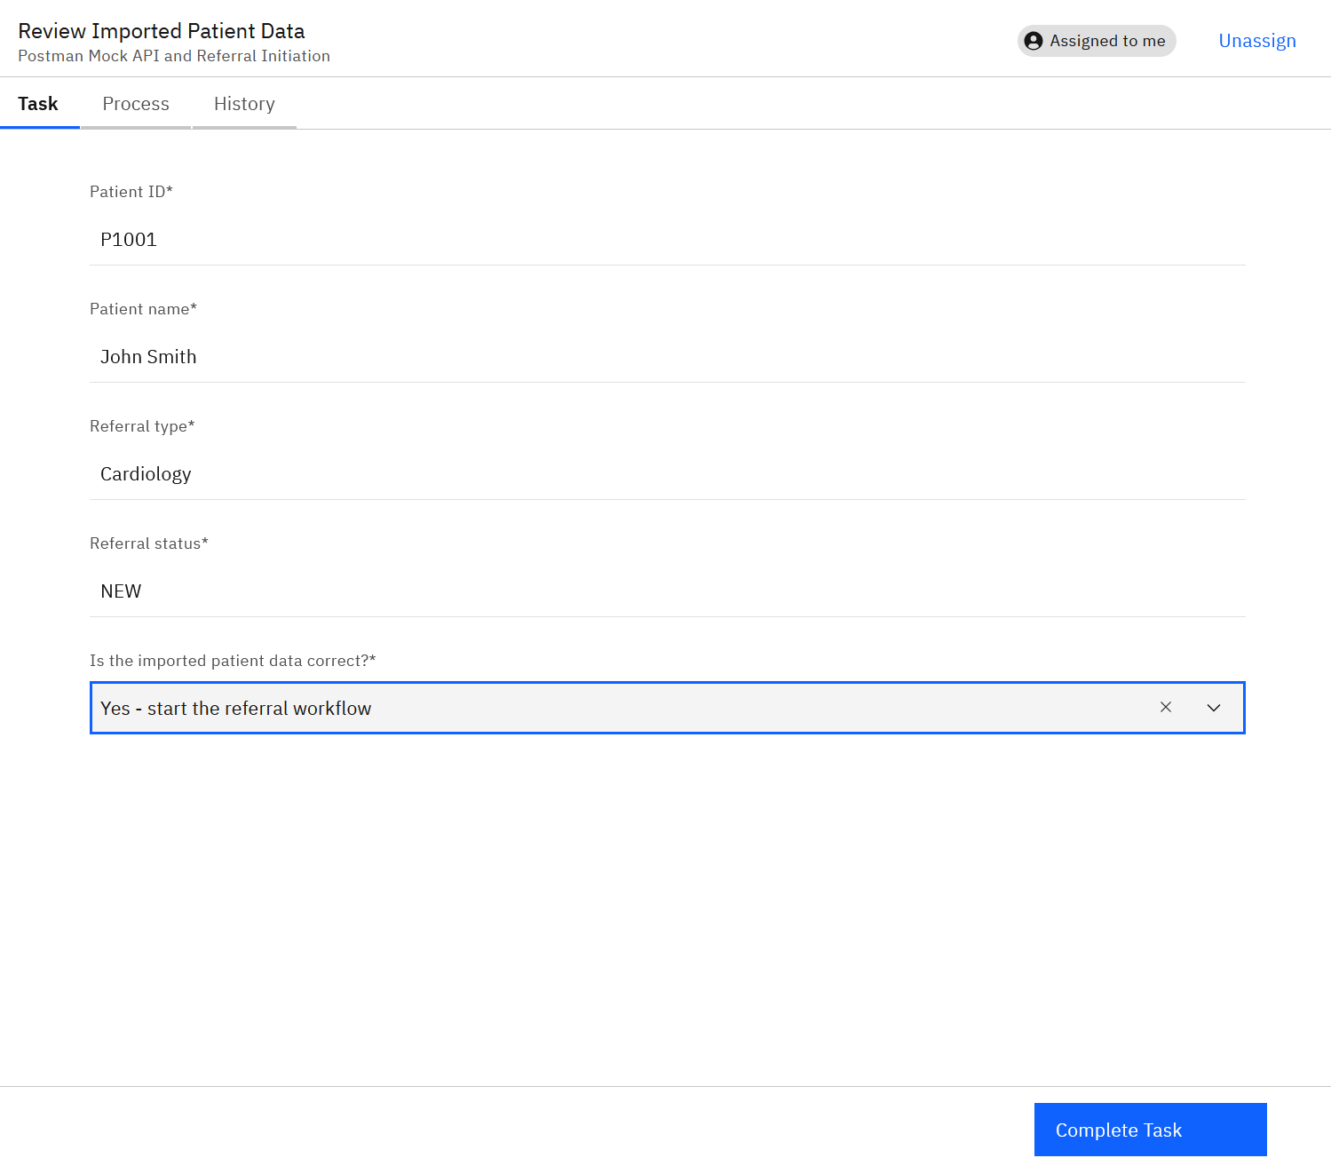
603 DEVELOPMENT PRESENTATION
Further Development: External API and Patient Confirmation
08
1. The local mock exposes GET /patients/next and returns one patient record for the BPMN route.
2. Retrieve Patient Details maps patientId, patientName, referralType and referralStatus into process variables.
3. The reviewer sees these values in Tasklist and actively chooses whether the imported data is correct. The XOR gateway only routes after this choice.
4. Update: the route was tested from API response to Tasklist confirmation, including a controlled missing-data branch.

Slide 8
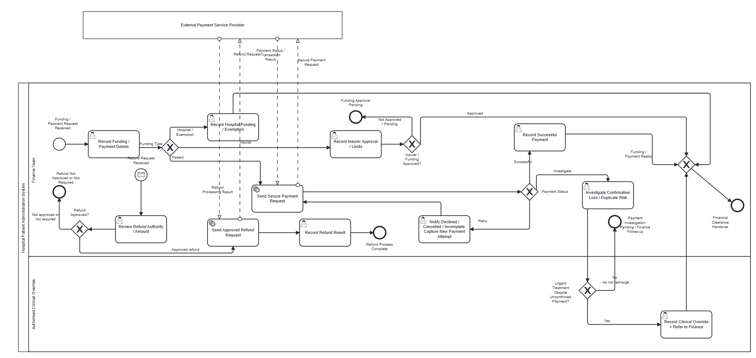
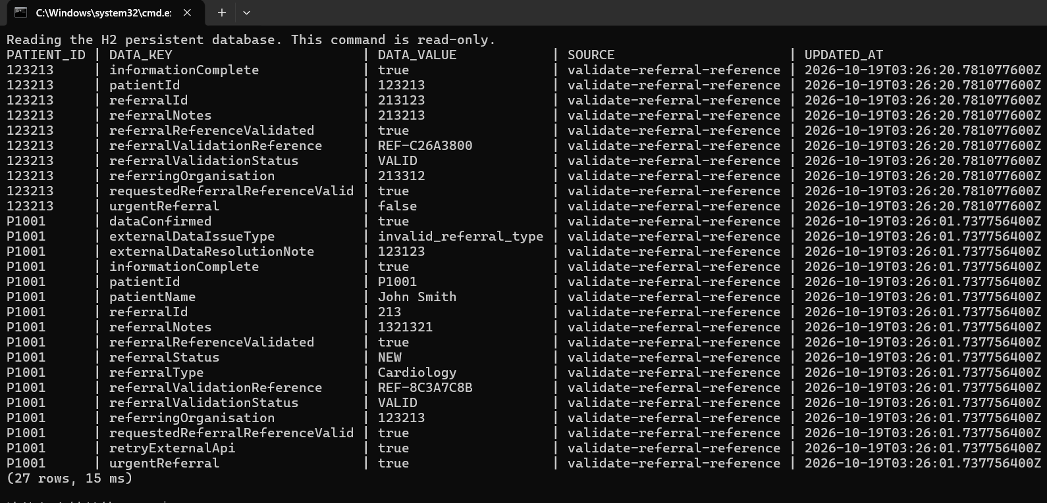
603 DEVELOPMENT PRESENTATION
Further Development: Finance and Persistent Data
09
1. Wu Tongyu developed the funding and payment route and implemented persistent patient application data.
2. The H2 repository stores application values under patientId so later workers can retrieve and update the same record.
3. Shared worker support merges existing saved values with values from the current task before writing the record back.
4. Progress: persistence moved from a feedback requirement to a tested reopening scenario.

Slide 9
603 DEVELOPMENT PRESENTATION
Teacher Feedback,
10
Feedback point
Priority decision and planned action
Form validation
Require valid inputs and use controlled options for routing values.
Merging gateways
Remove duplicate downstream paths and converge alternatives safely.
Forms for scenarios
Provide normal, exception and retry decisions in Tasklist.
Data persistence
Keep application data after worker restart and retrieve it by patientId.

Slide 10
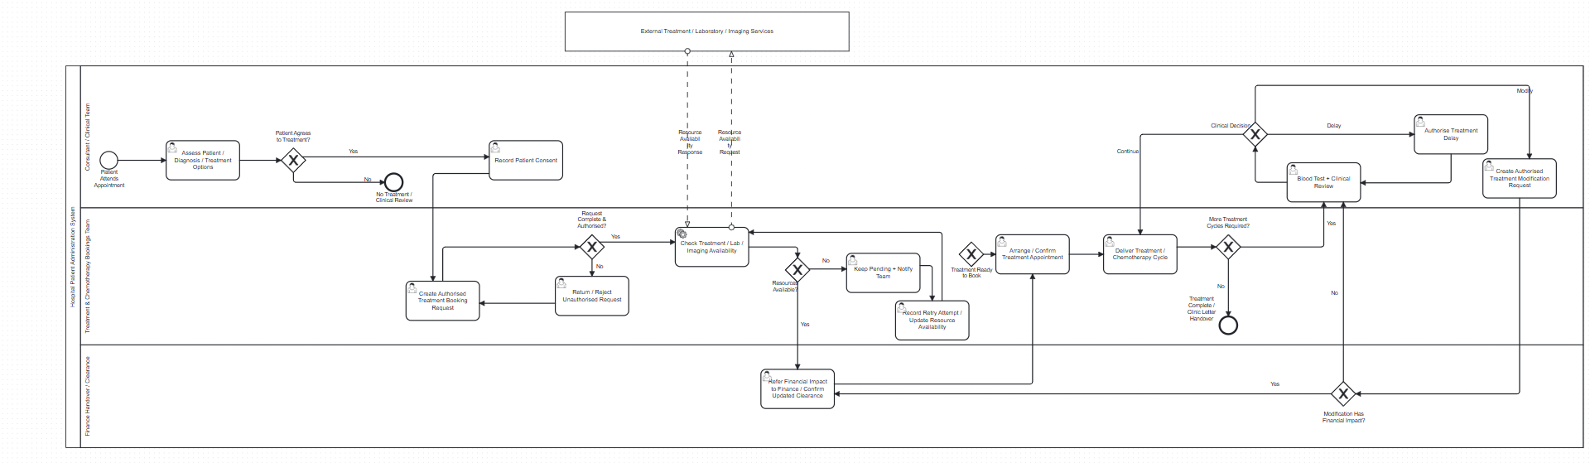
603 DEVELOPMENT PRESENTATION
Feedback Improvement: Clinical Form Validation
11
1. Lin Jiaqiang developed the treatment and chemotherapy route and strengthened clinical task validation.
2. Required patient, clinical, decision and outcome fields prevent a task from completing with missing values.
3. Controlled selections give gateways predictable values rather than relying on free text.
4. The improvement protects clinical safety because the process does not progress until required information is present.

Slide 11
603 DEVELOPMENT PRESENTATION
Feedback Improvement: Merging Gateways
12
1. A merging gateway brings alternative paths back into one controlled downstream path.
2. This prevents duplicated tasks after successful and corrected outcomes.
3. Release 2 uses named convergence points in Appointment, Finance, Treatment and Clinic Letter processes.
4. The appointment merge: separate booking outcomes converge before the shared notification or follow-up activity.

Slide 12
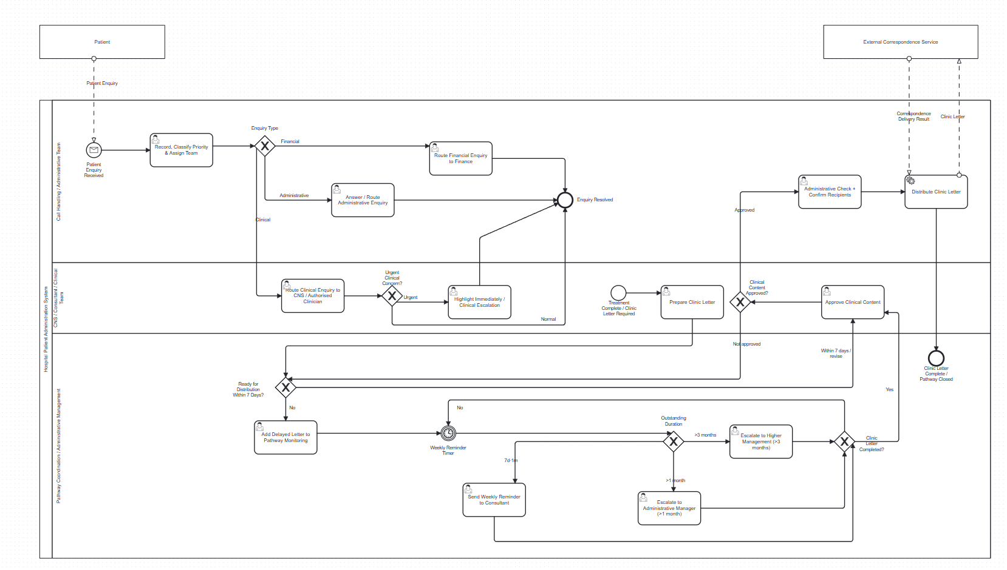
603 DEVELOPMENT PRESENTATION
Feedback Improvement: Forms for Business Scenarios
13
1. Yuying Xiao developed enquiry, clinic-letter and monitoring work.
2. The forms cover normal communication as well as delayed, missing or rejected information scenarios.
3. Each exception form captures the user decision needed to retry, escalate or end the route safely.
4. The forms turn business rules into visible and testable Tasklist behaviour.

Slide 13
603 DEVELOPMENT PRESENTATION
Feedback Improvement: Data Persistence
14
Response to Feedback | Wu Tongyu and SR4
1. A file-backed H2 database stores application data after the worker stops.
2. The system reads the existing record with patientId, combines it with current task values, then saves the updated record.
3. A reopening test confirms that a new repository instance can recover an earlier record.

Slide 14
603 DEVELOPMENT PRESENTATION
Project Plan: Baseline, Actual Progress and SU3
15
Project Plan Evaluation | SU3 embedded
Initial plan
Model requirements, ownership and an executable BPMN increment
All domain routes represented
Release 1 plan
Forms, workers, gateway conditions and integrated runtime
System ready for first demonstration
Actual Release 2
API intake, validation, merging controls, persistence and testing
Feedback converted into implemented improvements
update: each person reported completed work, next integration action, blocker and second-owner support. The evidence sits with the related contribution slides rather than in one separate section.

Slide 15
603 DEVELOPMENT PRESENTATION
Technical Implementation: API to BPMN Decision
18
How the API actually works
The Mock API returns one BPMN-safe patient object. The HTTP connector stores the JSON fields as process variables. Tasklist then captures the human decision. The XOR gateway evaluates that decision.
if (req.method === "GET" && req.url === "/patients/next") {
res.writeHead(200, JSON_HEADER);
res.end(JSON.stringify(nextPatient));
return;
}
Postman Mock
HTTP JSON
connector
BPMN variables
Tasklist confirmation
dataConfirmed
XOR gateway
The API does not choose Yes or No. It only supplies patient data. A user makes the choice in Tasklist, and the gateway follows the value submitted by the form.

Slide 16
603 DEVELOPMENT PRESENTATION
Technical Implementation: Java Worker and H2 Persistence
19
How persistent data actually works
Every worker uses the same support sequence: load the earlier patient record, add current job variables, run the domain handler, then save the combined record back to the file-backed H2 database.
input.putAll(repository.load(patientId));
input.putAll(submitted);
output = handler.apply(input);
record.putAll(output);
repository.save(patientId, jobType, record);
jdbc:h2:file:./data/hospital-applications
MERGE INTO application_data
(patient_id, data_key, data_value, source, updated_at)
KEY(patient_id, data_key)
Why this is persistent: the H2 JDBC URL points to a database file. Closing and restarting a worker does not delete the file, so a later job can load the same patientId record.
Zeebe variables belong to one process instance. Our repository adds durable patient application storage that later jobs and later instances can retrieve.

